Slide 1





Battleships
By NavyBoys

Slide 2



INTRODUCTION
Project lead- P. Thinh Nguyen
Specification lead- Zhaowen Gu
Interface lead- Nguyen Thinh Phuc
Technical lead- Thai Nguyen
Documentation lead- John McDonough

Slide 3

TABLE OF CONTENTS
01
03
OBJECTIVES
RESULTS
02
04
METHODOLOGY
CONCLUSIONS
What’s the game look like
Demonstration of code results
The architecture of program and how do we approach it

Slide 4


—Joyce Eilers & Bob Lowden
“Anchors aweigh, my boys, anchors aweigh.”

Slide 5

01
OBJECTIVES

Slide 6
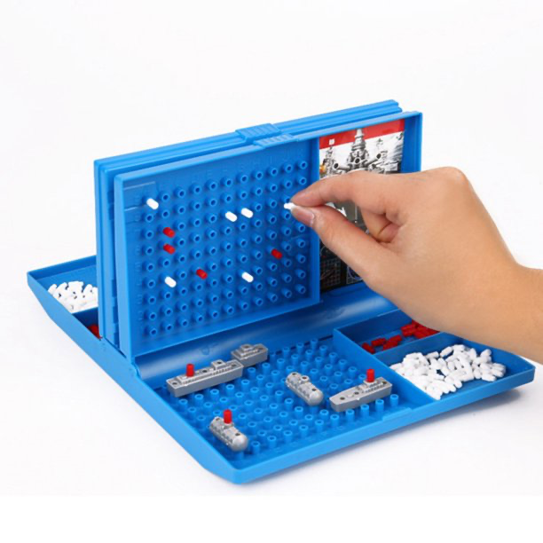
BATTLESHIP
-INSPIRED BY CLASSIC BOARD GAME- BATTLESHIP -ONLY SINGLE PLAYER -HAVE DIFFERENT TYPES OF BATTLESHIP -HAVE DIFFERENT LEVELS OF DIFFICULTY

Slide 7
02
METHODOLOGY

Slide 8
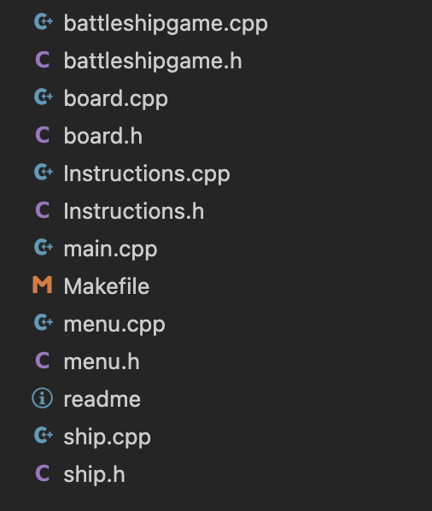
BATTLESHIP
- WE USE SIMILAR ARCHITECTURE LIKE PA3 AND PA4 -WE BREAK DIFFERENT FUNCTIONS OF THE GAME INTO SEPARATE FILE AND MADE A MAKEFILE -MENU IS RESPONSIBLE FOR THE STARTING SCREEN - CLASS SHIP IS RESPONSIBLE FOR GENERATING A NEW SHIP BASED ON COORDINATE GIVEN -INSTRUCTIONS PRINTS OUT THE INSTRUCTIONS AND THE MAP -BOARD IS RESPONSIBLE FOR GAME ACTIVITIES AND THEIR EFFECT ON MAP. WORKS LIKE VIEW IN PA3 - INITIALIZE GAME LIKE MODEL IN PA3

Slide 9
03
RESULTS

Slide 10
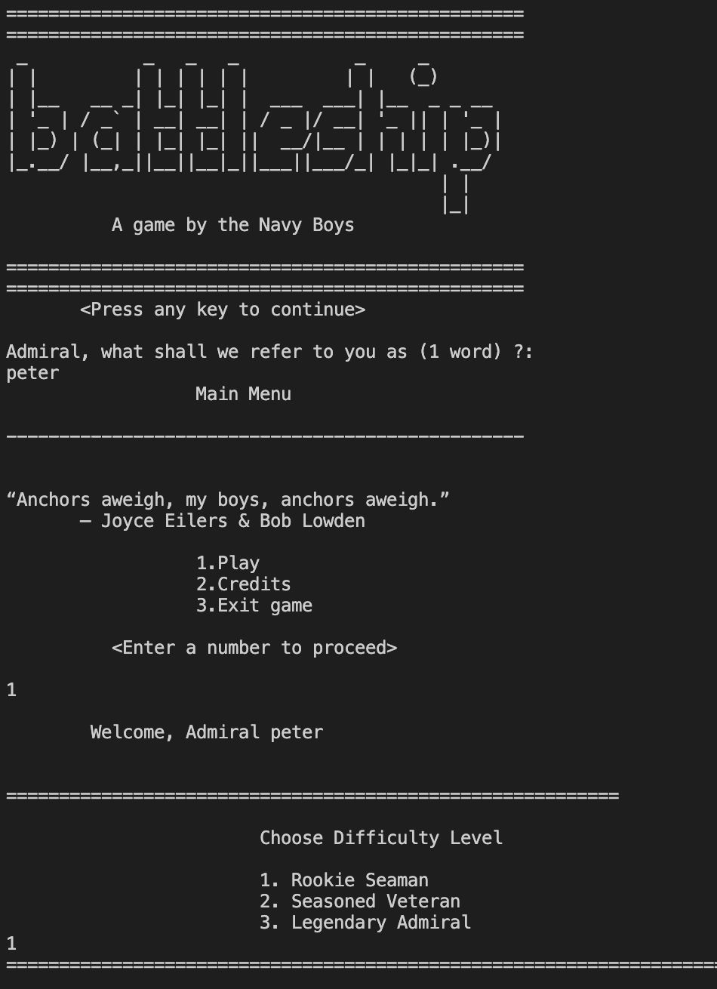
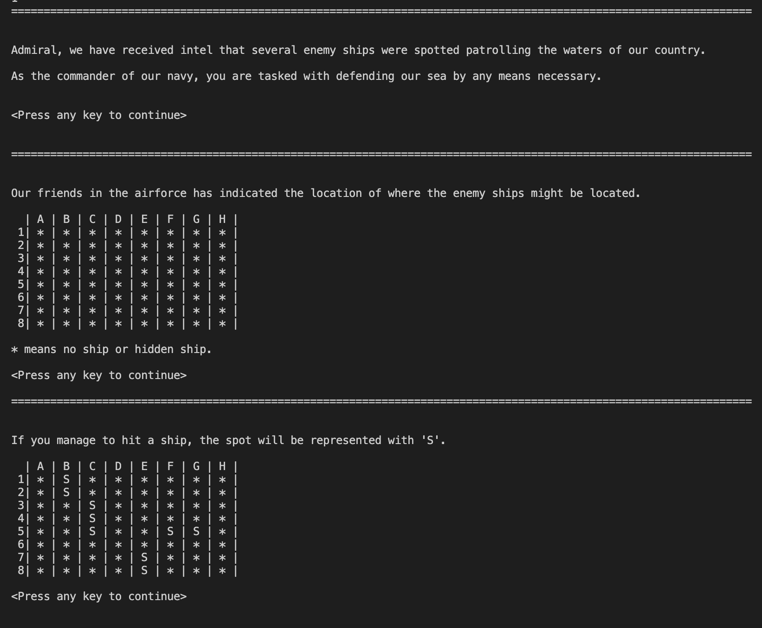
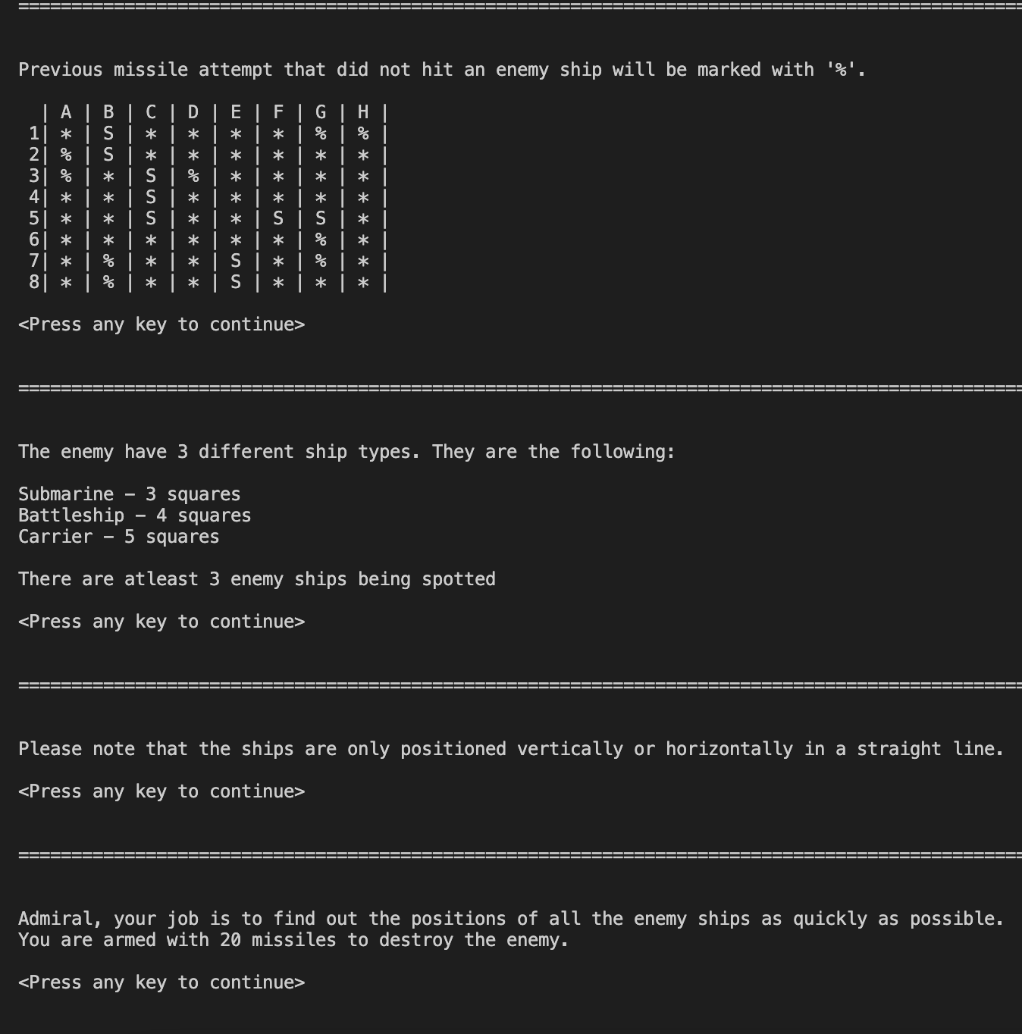
BATTLESHIP

Slide 11
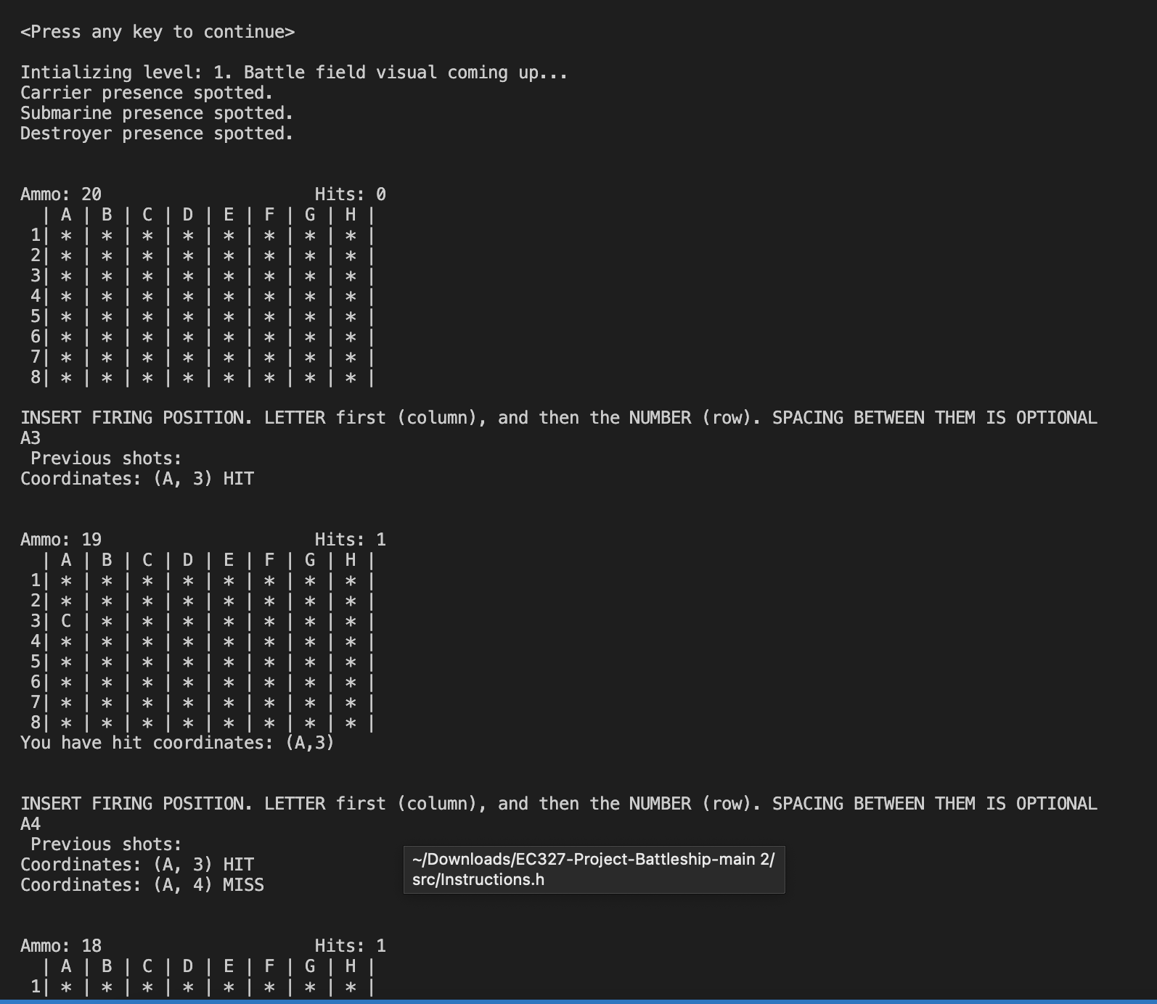
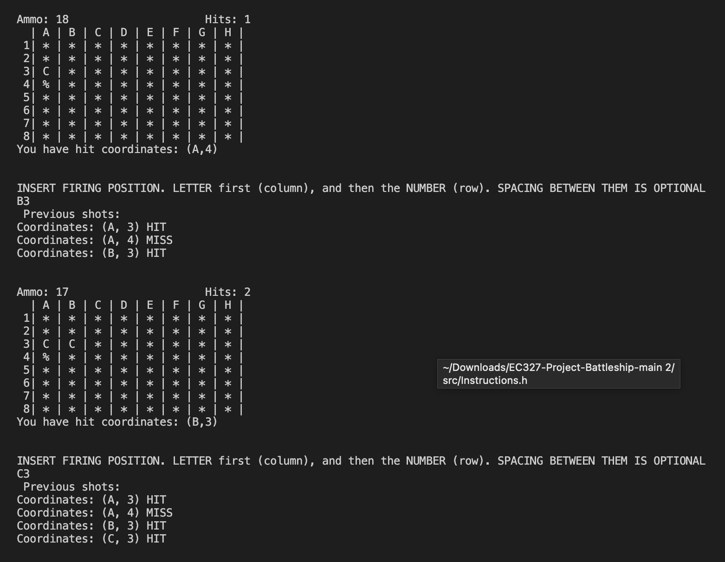
BATTLESHIP

Slide 12
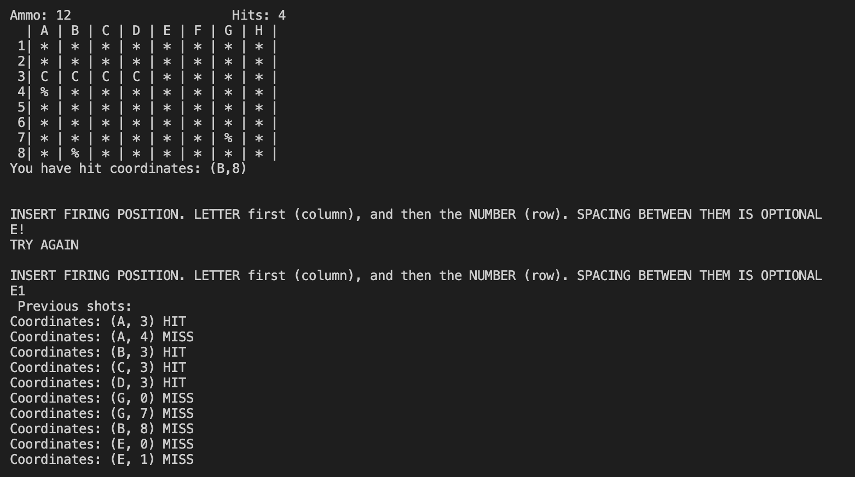
BATTLESHIP
-WE ALSO INCLUDE ERROR DETECTING METHODS THAT OUTPUTS ERROR MESSAGE -WE TRIED TO INCLUDE GAME AI BUT FAILED -WE TRIED TO INCLUDE A GUI BUT THE TOOLS REQUIRED ONLY WORKS FOR WINDOWS

Slide 13
04
CONCLUSTIONS

Slide 14
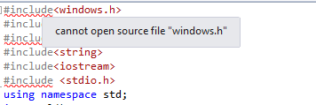
BATTLESHIP
-WE ALL WORK VERY HARD TO REACH THE FINAL EDITION OF THE GAME -WE DICUSSED MANY DIFFERENT VERSIONS BUT SOME FAILED TO IMPLEMENT SO NEXT TIIME WE CAN MAKE THE DISCUSSION MORE EFFIECENT -WE DID A GREAT JOB IN PLANNING THE GAME AND THE FLOW OF OUR GAME IS PERFECT!

Slide 15

THANK YOU!

